Slide 1
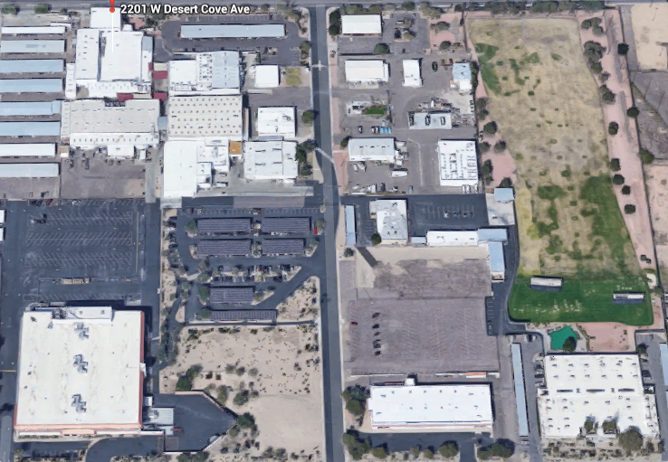

New Equipment Considerations
2017 – Thing that make one go hmmm
(Addition of New Diesel Generator)
https://youtu.be/XF2ayWcJfxo?t=95

Slide 2
Non-Title V Air Permit PING Major Activities
Solvents used in cleaning
Painting
Cutting, Grinding, Blasting
On-site vehicle Usage(fuels and dust control)
Emergency Generation Diesel Generators

Slide 3
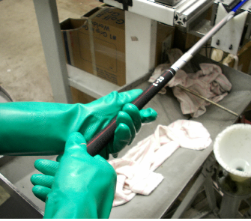
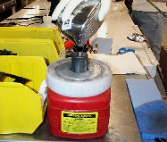
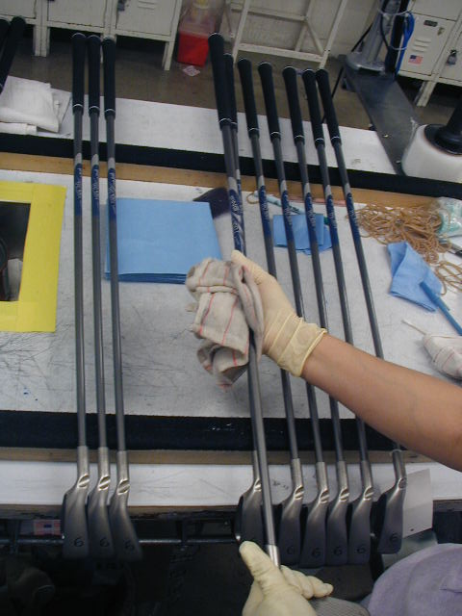
Solvents Used In Assembly
Notes:
During the assembly process, we grip clubs, paint color-codes, and wipe/clean the clubs before we ship. These processes can cause air pollution as well as creates used rags which need to be disposed.

Slide 4
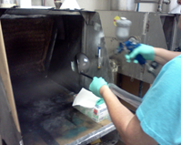
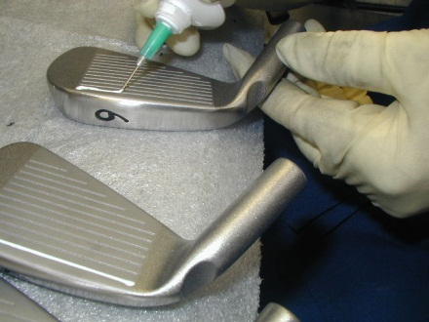
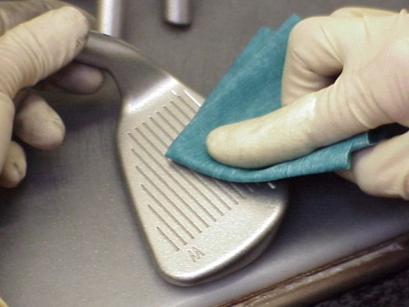
Painting related activities
Notes:
We paint clubs as well as wipe them with chemicals. The painting and wiping process can cause air pollution as well as creates used rags which need to be disposed.

Slide 5
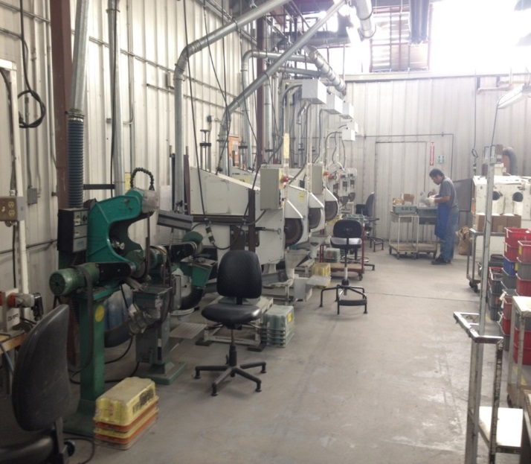
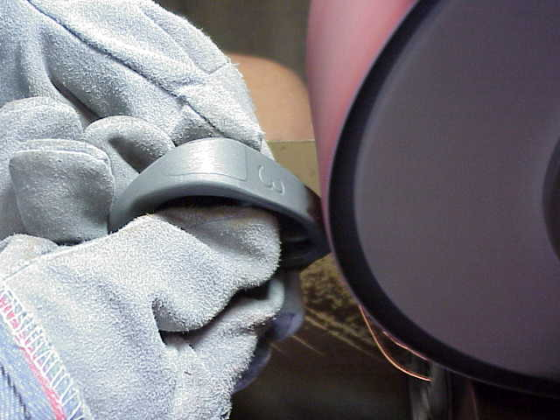
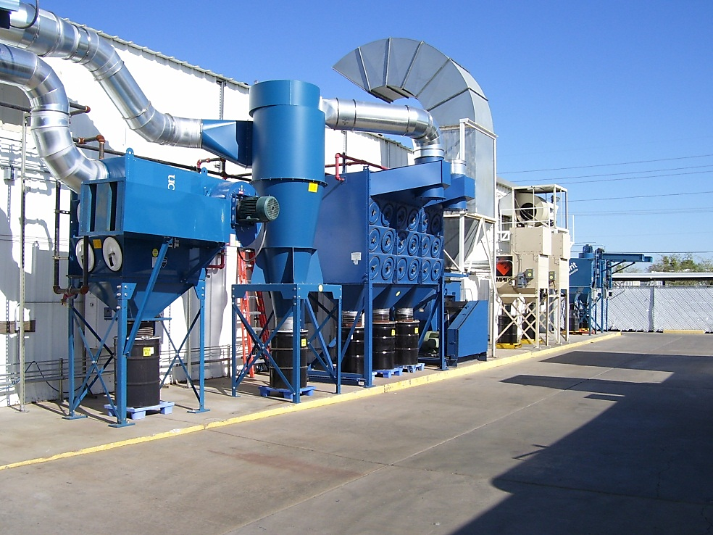
Grinding & Blasting
Notes:
We grind the clubs. The dust from the clubs contains metal. The metal dust is captured in a dust collector. We recycle the metal dust.
We sand blast the clubs. The used sand is captured in a dust collector. We send the used sand to a landfill. Maybe we can find a better use for the used sand.
We tumble the clubs. The wastewater that is generated from the tumblers contains metals. We send the wastewater to our water treatment plant which removes the metals from the wastewater. Right now, we send the cleaned water to the sewer. Maybe we can recycle the water.

Slide 6
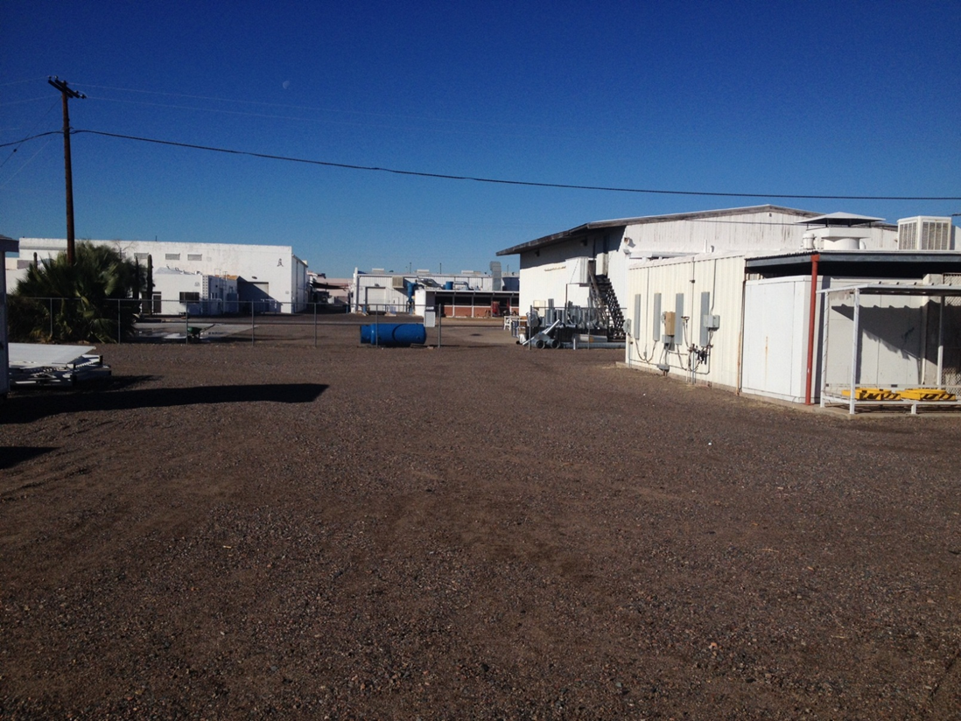
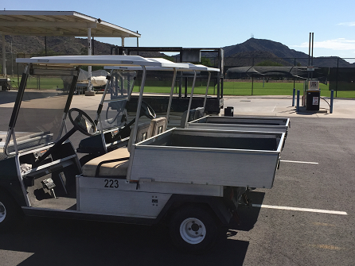
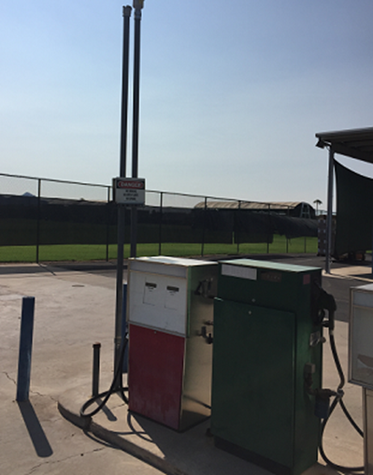
Vehicle Fuel Usage and Dust Control
Notes:
Non-Title V Permit – Recent air quality inspection with no findings.
Sources: Metal finishing and Abrasive Blasting

Slide 7
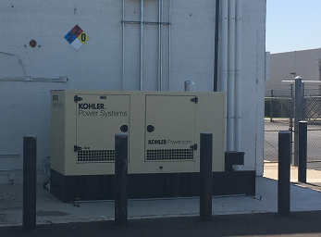
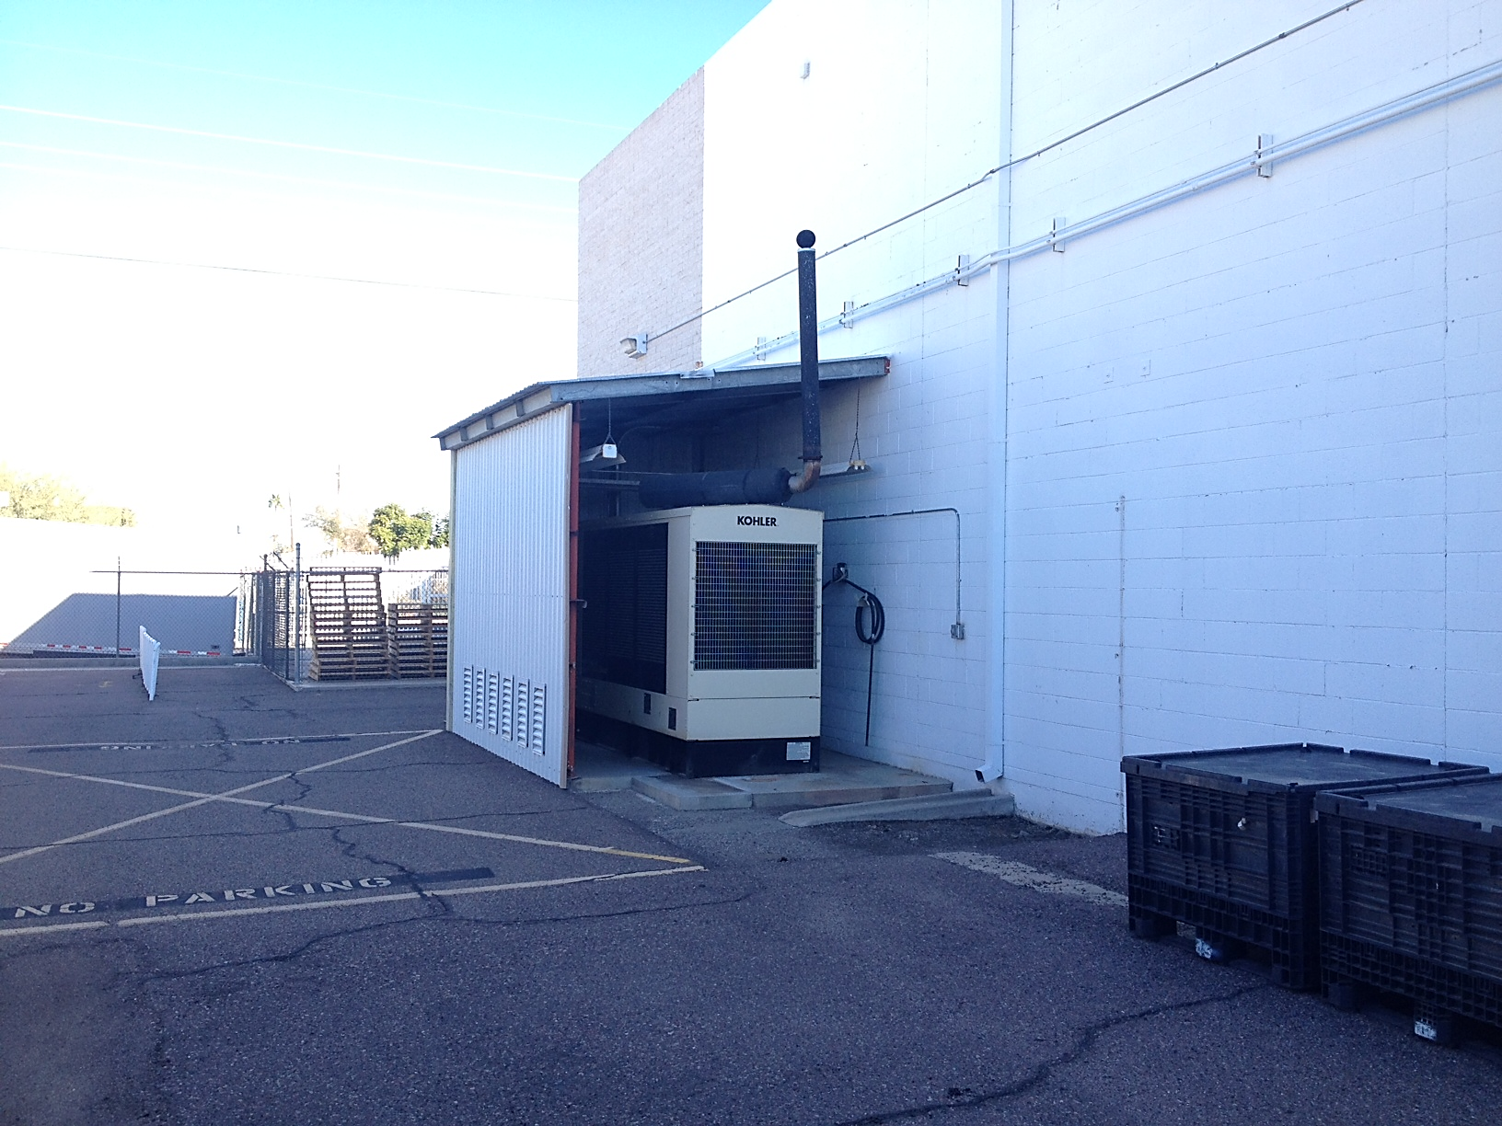
Diesel Generators
New
Old
Notes:
Sources: Emergency power generation and dust control.

Slide 8
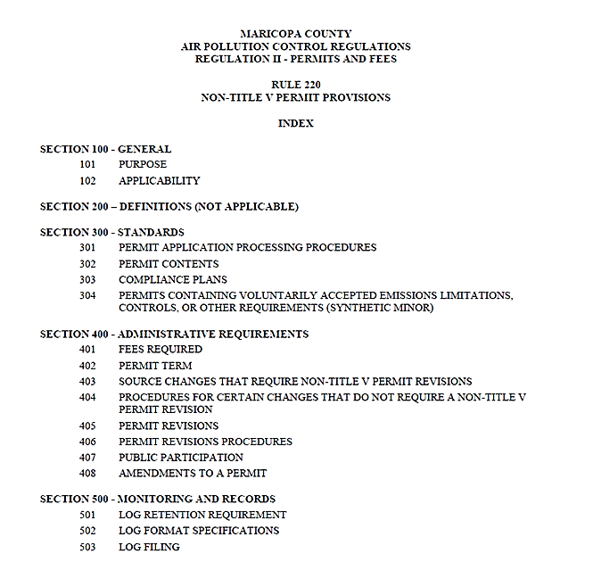
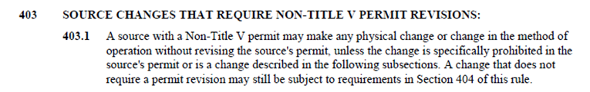
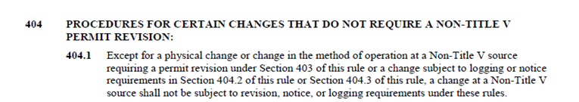
Notes:
Review Rule 220.
We already have a requirement in our permit – 30 day notice.

Slide 9
Q and A (Air Permit Related)
Questions from AQDX
PING Answers
I have a question about the new emergency generator you are adding, as per your application for a minor mod of permit #020084.
The application states that it is a Tier 3. Since the application shows only the date of installation, we will need the date of manufacture of this engine.
Attached showing that it is Tier 3 EPA Certified in the spec sheet section.).
I do not see the actual date of manufacture for the engine, so I requested this from our installation contractor and I will send this to you as soon as received.

Slide 10
Q and A (Air Permit Related)
Questions from AQDX
PING Answers
Loading of Gasoline revision:
  The Permittee shall only load, allow the loading, or provide equipment for the loading of gasoline from only a gasoline cargo tank identified with a valid Maricopa County Vapor Tightness Test decal that is permanently mounted near the front on the right (passenger) side of the vessel into any stationary gasoline storage tank unless one of the following conditions are met:
    The owner or operator of the gasoline cargo tank submits a signed affidavit to the Control officer documenting compliance with Sections 103.2.a(1)-(4) of Rule 352 and a copy of the signed affidavit is available in the gasoline cargo tank for inspection; or
Attached showing that it is Tier 3 EPA Certified in the spec sheet section.).
I do not see the actual date of manufacture for the engine, so I requested this from our installation contractor and I will send this to you as soon as received.

Slide 11
NR and A (Air Permit Related)
New request from AQDX
PING resolution
Gasoline Storage Equipment and Operation Requirements:
The Permittee shall not transfer or permit the transfer of gasoline from any gasoline delivery vessel into any stationary dispensing tank with a tank capacity of more than 250 gallons unless the following requirements are met:
  Each underground storage tank (UST) shall comply with the following:
    A pressure-vacuum vent shall be installed and maintained per manufacturer’s specifications;
Pressure-vacuum caps were installed for the gasoline stack as requested.

Slide 12
Q and A (Air Permit Related)
Questions from AQDX
PING Answers
When was the engine manufactured ?
Since the application shows only the date of installation, we will need the date of manufacture of this engine.
Attached showing that it is Tier 3 EPA Certified in the spec sheet section.).
I do not see the actual date of manufacture for the engine, so I requested this from our installation contractor.
They Indicated that it was September 2106.

Slide 13
Q and A (Air Permit Related)
Questions from PING
AQDX Answers
One question I have from my read of the draft permit is related to our emergency generators. The permit states that The Permittee shall limit the total hours of operation of the emergency engines to no more than 500 hours each per any twelve consecutive months including the hours listed in Subsection [a] above.
Since we have a new diesel fueled emergency generator, is this condition for each generator or a combination of the both?
To answer your question, the 500 hours are for each engine.
Including the 100 hours for maintenance for that engine only.

Slide 14
R and A (Air Permit Related)
Requests from PING
AQDX Answers
PING’s current permit references a MeCl limit usage in Condition 25 (Condition 27 in the draft) . However, Condition 21 states that PING shall not use chemical strippers that contain MeCl.
We are not currently using MeCl. However, we request to continue to have the current permit condition in place to allow for its future use and operational flexibility.
PING requests that the language be consistent within the Draft Permit and the conditions are supported by the applicable rules.
Removed 21.b for consistency with PC#27.
27 Operating Limits:
The Permittee shall limit the usage of methylene chloride (MeCl) to no more than 67 gallons per rolling 12-month period.

Slide 15
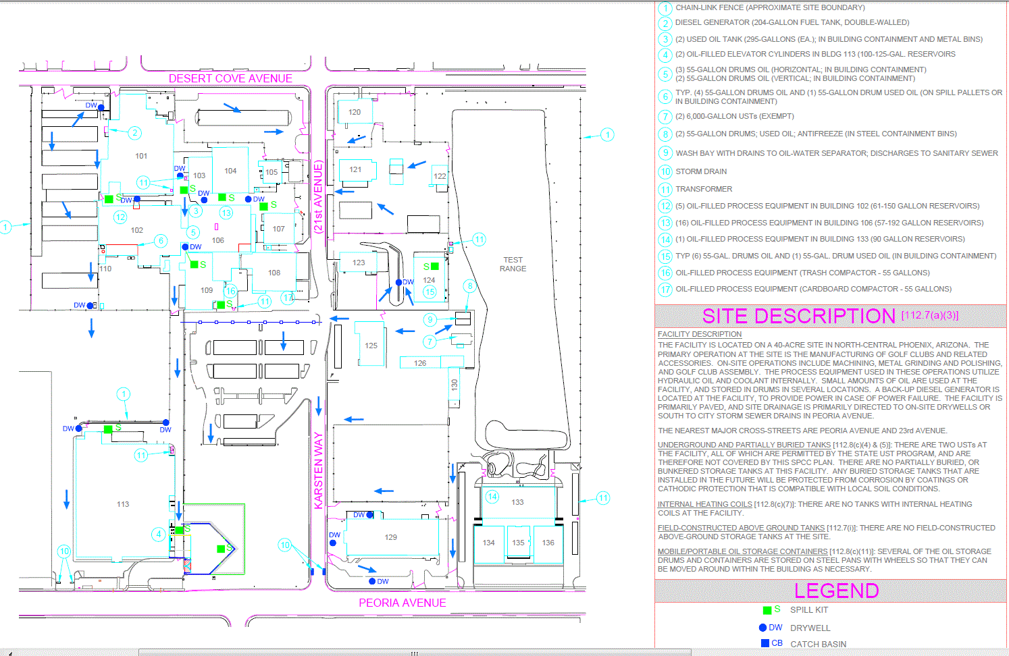
Other Changes (Not directly related to Non-Title V)
Spill Prevention Control and Countermeasures Plan and Storm Water Pollution Prevention Plan Changes.
PING needed to update both plans and add the new generator to site numerous maps

Slide 16
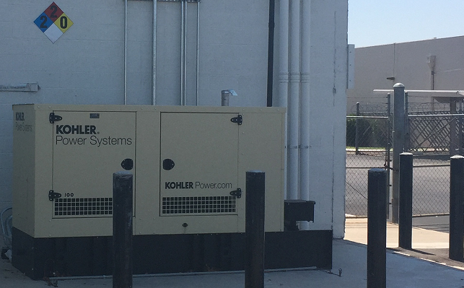
Other Changes (Not directly related to Non-Title V)
The Hazardous Waste Contingency Plan, Fire Maps and NFPA required signage needed to be changed or added.

Slide 17



Conclusions - Learn Be Proactive
(Top 3 new AQ Rules)

Slide 18
Comments, Questions
And
Thank You!

